Slide 1



Exhaustive Analysis of Indian Agriculture using Power BI

Slide 2

Learning Objectives
Data Exploration: Utilized Power BI visualizations, such as tables, to examine state, district, and yearly data structures.
Major Crops Analysis: Studied cultivation trends of key crops like rice, wheat, and pulses, focusing on variations in area, production, and yield.
State Analysis: Evaluated crop cultivation patterns and production levels across different states.
Seasonal Analysis: Investigated seasonal cultivation trends, differentiating between kharif and rabi seasons.
Fruits and Vegetables Analysis: Assessed the growth patterns of fruits and vegetables and their overall impact on agricultural practices.
GOAL
Source: www.freepik.com

Slide 3
Tools and Technology used
Power BI for data visualization and interactive dashboards.
Excel for data exploration.
Story telling
Data analysis

Slide 4
Problem Statement:
This project examines Indian agriculture by analyzing district-level and yearly data. The dataset provides insights into crop area, production, and yield trends across various regions and time periods. Using Power BI, we create interactive visualizations to identify agricultural patterns and disparities, supporting stakeholders in making data-driven decisions for sustainable farming and efficient resource distribution.

Slide 5
Solution:
Dynamic Power BI dashboards showcasing agricultural trends across districts and years.
Visual analytics illustrating shifts in major crop production and changes over time.
Comprehensive reports highlighting regional disparities, seasonal trends, and external influences.
Actionable insights for policymakers and agricultural stakeholders to enhance decision-making.

Slide 6
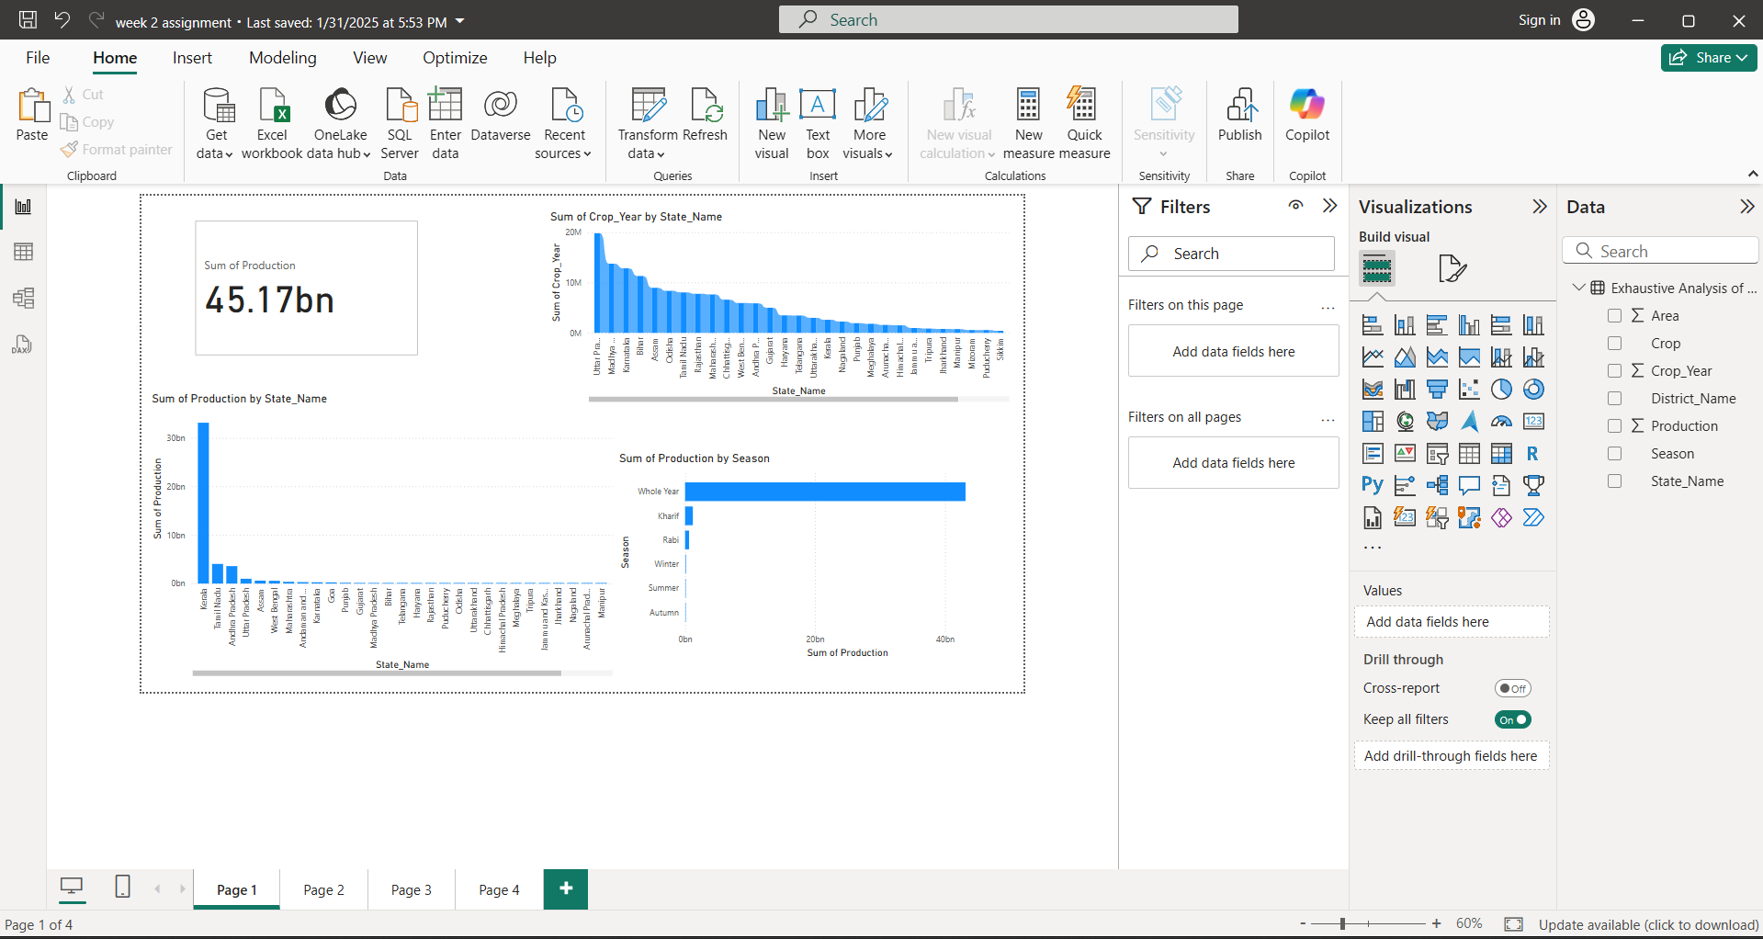
Screenshot of Output:

Slide 7
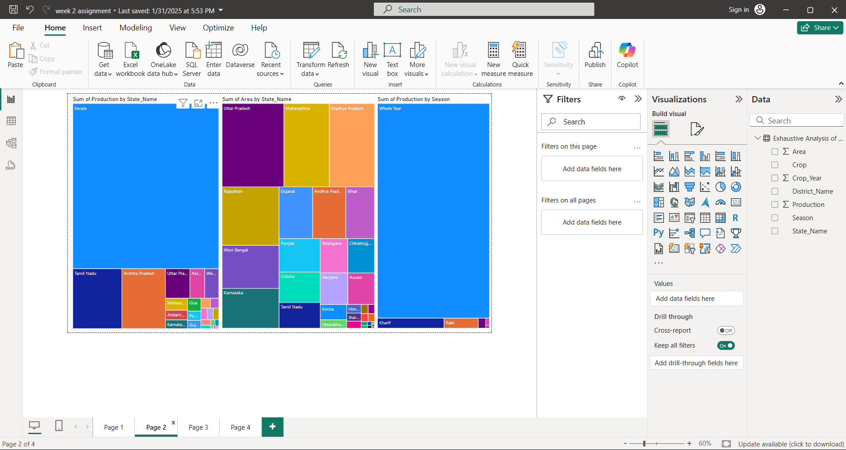

Slide 8
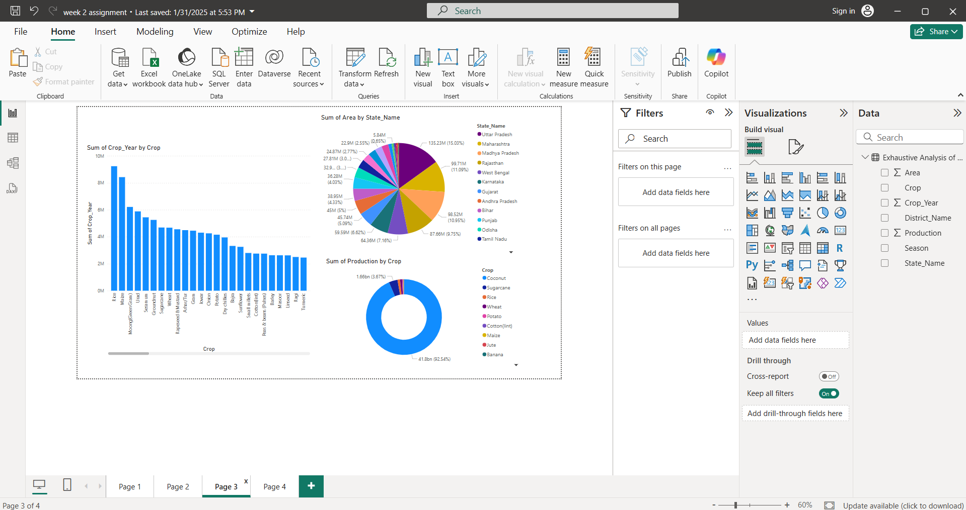

Slide 9
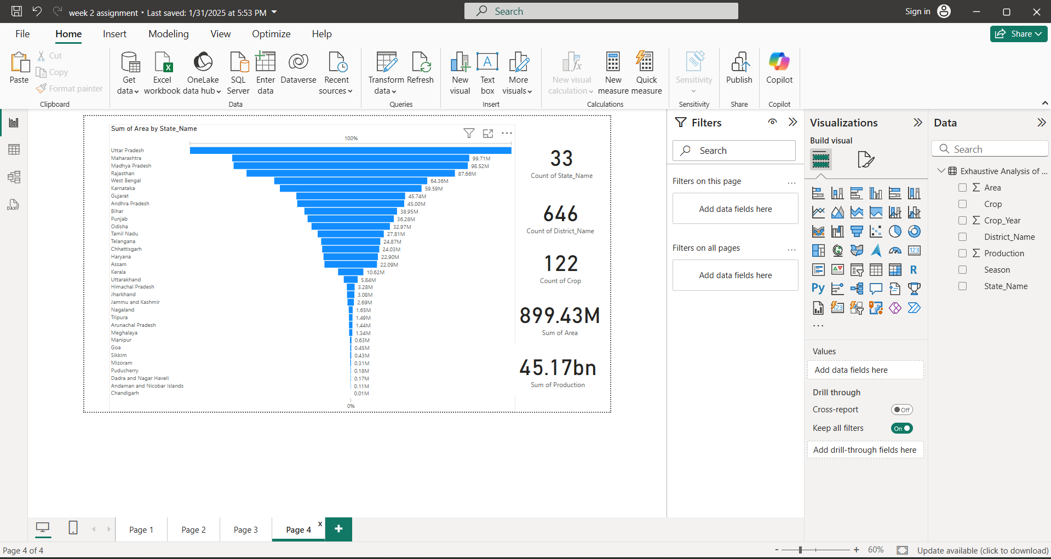

Slide 10
Conclusion:
This project provides interns with an opportunity to gain hands-on experience in agricultural data analysis and visualization using Power BI, contributing valuable insights to enhance agricultural practices and decision-making in India.

